Slide 1
Front-end Development
Introduction to CSS
CSS stands for Cascading Style Sheets. It is the language for describing the presentation of Web pages, including colours, layout, and fonts, thus making our web pages presentable to the users.
If HTML is the skeleton of a website, CSS is the skin, hair an nails.

Slide 2
Front-end Development
CSS stands for Cascading Style Sheets. It is the language for describing the presentation of Web pages, including colours, layout, and fonts, thus making our web pages presentable to the users.
If HTML is the skeleton of a website, CSS is the skin, hair and nails.
Introduction to CSS

Slide 3
Front-end Development
HTML was NEVER intended to contain tags for formatting a web page!
HTML was created to describe the content of a web page,
When tags like <font>, and color attributes were added to the HTML 3.2 specification, it started a nightmare for web developers. Development of large websites, where fonts and color information were added to every single page, became a long and expensive process.
To solve this problem, the World Wide Web Consortium (W3C) created CSS.
CSS removed the style formatting from the HTML page!
Introduction to CSS

Slide 4
Front-end Development
HTML was NEVER intended to contain tags for formatting a web page!
HTML was created to describe the content of a web page,
When tags like <font>, and color attributes were added to the HTML 3.2 specification, it started a nightmare for web developers. Development of large websites, where fonts and color information were added to every single page, became a long and expensive process.
To solve this problem, the World Wide Web Consortium (W3C) created CSS.
CSS removed the style formatting from the HTML page!
Introduction to CSS

Slide 5
Front-end Development
Introduction to CSS
CSS selectors are used to "find" (or select) the HTML elements you want to style.
We can divide CSS selectors into five categories:
Simple selectors (select elements based on name, id, class)
Combinator selectors (select elements based on a specific relationship between them)
Pseudo-class selectors (select elements based on a certain state)
Pseudo-elements selectors (select and style a part of an element)
Attribute selectors (select elements based on an attribute or attribute value)

Slide 6
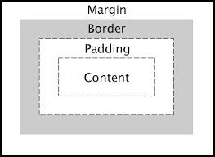
Front-end Development
The Box Model
Content
The element's content forms the innermost box. The width and height properties set the dimensions of the content box, like this, width: 100px; height: 200px;, which sets the content box to 100px by 200px. This area contains the text or image for the element.

Slide 7
Front-end Development
The Box Model
Padding
This forms a transparent area around the content that extends from the outer edge of the content box to the inner edge of the border. The size of this area can be set at once for all four sides using the padding property, like this, padding: 10px, which sets a padding of 10px around the content. You can also set the individual sides one at a time by using the padding-top, padding-right, padding-bottom, and padding-left properties.

Slide 8
Front-end Development
The Box Model
Border
The border is an area around the padding that extends from the outer edge of the padding box to the inner edge of the margin. By default, the size of the border is 0 which makes it invisible or non-existent. You need to set the thickness, style, and color to make it visible. It can be set for all four sides using the border shorthand property, like this, border: 2px solid black which sets a border of thickness 2px, in a solid line style, and black in color.

Slide 9
Front-end Development
The Box Model
Margin
The margin is the outermost layer, wrapping the content, padding, and border as whitespace between this box and other elements. Its size can be controlled using margin and related properties.

Slide 10
Front-end Development
Introduction to Flexbox
The main idea behind the flex layout is to give the container the ability to alter its items’ width/height (and order) to best fill the available space (mostly to accommodate to all kind of display devices and screen sizes). A flex container expands items to fill available free space or shrinks them to prevent overflow.

Slide 11
Front-end Development
Introduction to Flexbox
Most importantly, the flexbox layout is direction-agnostic as opposed to the regular layouts (block which is vertically-based and inline which is horizontally-based). While those work well for pages, they lack flexibility to support large or complex applications (especially when it comes to orientation changing, resizing, stretching, shrinking, etc.)..

Slide 12
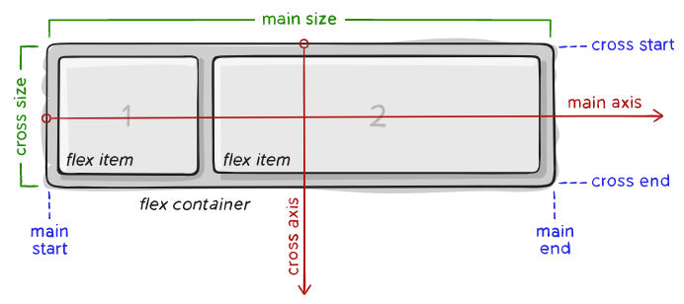
Front-end Development
The Flexbox Model
Items will be laid out following either the main axis (from main-start to main-end) or the cross axis (from cross-start to cross-end).

Slide 13
Front-end Development
The Flexbox Model
main axis – The main axis of a flex container is the primary axis along which flex items are laid out. Beware, it is not necessarily horizontal; it depends on the flex-direction property (see below).

Slide 14
Front-end Development
The Flexbox Model
main-start | main-end – The flex items are placed within the container starting from main-start and going to main-end.

Slide 15
Front-end Development
The Flexbox Model
main size – A flex item’s width or height, whichever is in the main dimension, is the item’s main size. The flex item’s main size property is either the ‘width’ or ‘height’ property, whichever is in the main dimension.

Slide 16
Front-end Development
The Flexbox Model
cross axis – The axis perpendicular to the main axis is called the cross axis. Its direction depends on the main axis direction.

Slide 17
Front-end Development
The Flexbox Model
cross-start | cross-end – Flex lines are filled with items and placed into the container starting on the cross-start side of the flex container and going toward the cross-end side

Slide 18
Front-end Development
The Flexbox Model
cross size – The width or height of a flex item, whichever is in the cross dimension, is the item’s cross size. The cross size property is whichever of ‘width’ or ‘height’ that is in the cross dimension.

Slide 19
Front-end Development
The Flexbox Properties
https://css-tricks.com/snippets/css/a-guide-to-flexbox/#flexbox-properties

Slide 20
Front-end Development
Introduction to CSS Grid
Why do we need CSS Grid if we already have CSS flexbox?
Technically there is no standard way to write CSS. You can build the whole UI of a project with just flexbox. But through the years web designers have a preferred way of writing css that makes it easier and faster.
Flexbox layout is most appropriate to the components of an application, and small-scale layouts, while the Grid layout is intended for larger scale layouts.

Slide 21
Front-end Development
Introduction to CSS Grid
CSS Grid Layout (aka “Grid” or “CSS Grid”), is a two-dimensional grid-based layout system that, compared to any web layout system of the past, completely changes the way we design user interfaces. CSS has always been used to layout our web pages, but it’s never done a very good job of it. First, we used tables, then floats, positioning and inline-block, but all of these methods were essentially hacks and left out a lot of important functionality (vertical centering, for instance).

Slide 22
Front-end Development
Introduction to CSS Grid
To get started you have to define a container element as a grid with display: grid, set the column and row sizes with grid-template-columns and grid-template-rows, and then place its child elements into the grid with grid-column and grid-row.

Slide 23
Front-end Development
Important Terminologies
Reading Assignment
Try to practice on your with css grid.
I recommend this course
Learn CSS Grid with Wes Bos
https://css-tricks.com/snippets/css/complete-guide-grid/

